Slide 1
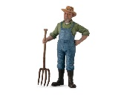
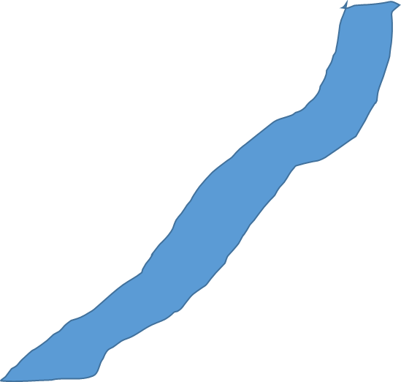
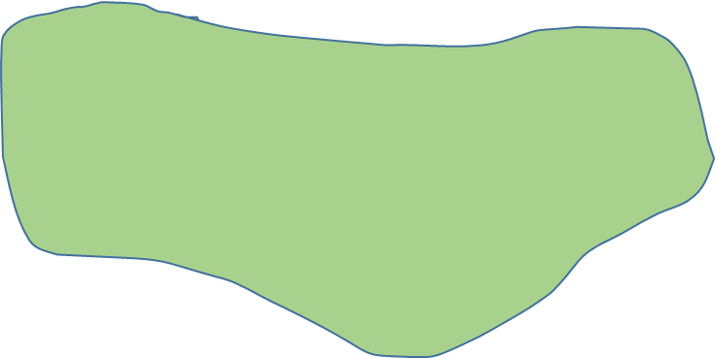
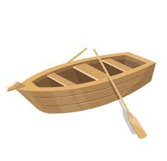



The Farmer Problem
“A farmer wants to move himself, a silver fox, a fat goose, and some tasty grain across a river. Unfortunately, his boat is so tiny, that he can only take one of his possessions across on any trip.
Worse yet, an unattended fox will eat the goose, and an unattended goose will eat the grain, so the farmer must not leave the fox alone with the goose, or the goose alone with the grain.
What has he to do?”

Slide 2
State graph in the state space

Slide 3




A UML diagram - participating actors and objects
aFox:Fox
aGoose:Goose
aGrain:Grain
aBoat:Boat
F:Farmer
get(aGoose)
load(aGoose)
crossRiver(aBoat)
leave(aGoose)
crossRiver(aBoat)
get(aFox)
load(aFox)
crossRiver(aBoat)
leave(aFox)
get(aGoose)
load(aGoose)
crossRiver(aBoat)
leave(aGoose)
get(aGrain)
load(aGrain)
crossRiver(aBoat)
leave(aGrain)
crossRiver(aBoat)
get(aGoose)
load(aGoose)
crossRiver(aBoat)
leave(aGoose)
lifeline
activation
messages

